Slide 1
IU CLOUD PROGRAMMING · TASK 2
Secure and Globally Distributed
Static Website on AWS
Using Terraform
Mahmoud Kanaan · 92133250 · DLBSEPCP01_E
17 July 2026
01

Slide 2
Static delivery still demands production quality
The challenge
01
HIGH AVAILABILITY
Managed, multi-AZ origin
Publish one self-contained HTML page worldwide without operating servers or exposing its storage origin.
02
GLOBAL DELIVERY
CloudFront edge network
03
AUTOMATIC SCALE
No fixed server capacity
04
SECURITY
HTTPS + private S3 origin
05
REPRODUCIBILITY
Terraform-defined lifecycle
DLBSEPCP01_E · Mahmoud Kanaan
02

Slide 3
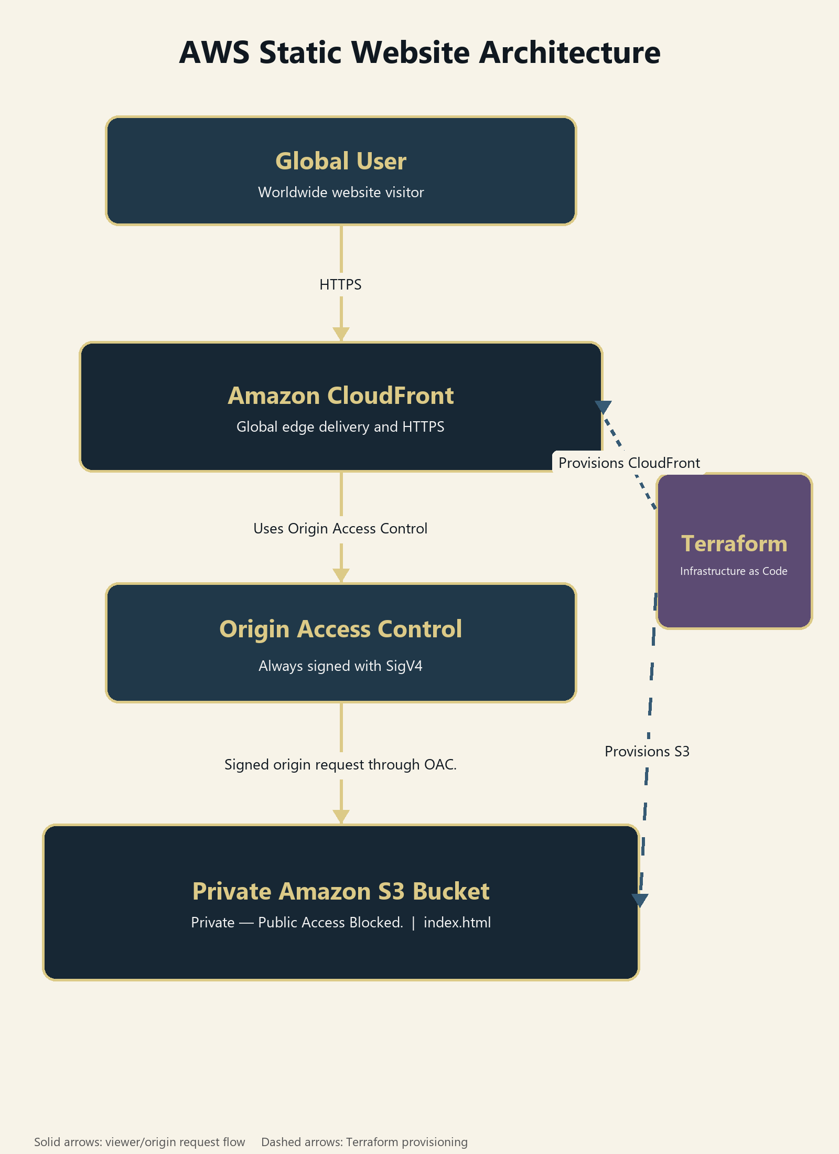
CloudFront serves users while S3 stays private
REQUEST PATH
1 User requests the CloudFront URL over HTTPS.
2 CloudFront serves a cached copy or signs an origin request through OAC.
3 S3 returns index.html only to the designated distribution.
PROVISIONING FLOW
Terraform creates and links S3, OAC, CloudFront and the restricted bucket policy.
Figure 1. Request flow (solid) and Terraform provisioning (dashed).
03

Slide 4
Four managed services meet the requirement
S3
CloudFront
Durable managed storage for one static object.
Global HTTPS delivery, caching and compression.
OAC
Terraform
SigV4 origin requests and distribution-scoped access.
Versioned, reviewable and repeatable infrastructure.
REJECTED ALTERNATIVES
EC2 + load balancer add operating systems, patching, compute targets and cost without providing value to a static one-object site. ECS, Lambda, API Gateway and databases are also unnecessary.
Sources: AWS CloudFront, S3 and OAC documentation; HashiCorp Terraform documentation.
04

Slide 5
Terraform makes the architecture repeatable
FILE STRUCTURE
WORKFLOW
01
terraform init
Provider + lock file
main.tf
variables.tf
outputs.tf
.terraform.lock.hcl
site/
└─ index.html
diagrams/
└─ architecture-diagram.png
02
terraform fmt / validate
Syntax and consistency
03
terraform plan
Review expected resources
04
terraform apply
Create or update AWS
Stable first draft
https://github.com/MahmoudBKanaan/AWS-Deployment/tree/portfolio-part-2-first-draft/iu-cloud-programming
Git tag: portfolio-part-2-first-draft
05

Slide 6
Security is enforced at every boundary
1
VIEWER
HTTP redirects to HTTPS
CloudFront default TLS certificate
2
EDGE → ORIGIN
OAC signs every S3 request
Bucket policy requires matching AWS:SourceArn
3
STORAGE
All four Public Access Block settings enabled
BucketOwnerEnforced · AES256 · versioning
4
SOURCE
No credentials in code or outputs
State, plans, keys and .env excluded from Git
Effective result: CloudFront is the only permitted reader of index.html.
DLBSEPCP01_E · Mahmoud Kanaan
06

Slide 7
Managed services remove capacity limits
01
02
03
04
S3 ORIGIN
CLOUDFRONT EDGE
CACHING
SCALING
Multi-AZ managed storage
Worldwide points of presence
Managed-CachingOptimized
AWS-managed capacity
No web server fleet
Low-latency delivery
Fewer origin requests
No capacity planning
The architecture scales by service design—not by forecasting server capacity.
PriceClass_All was chosen to prioritize worldwide reach over regional cost savings.
07

Slide 8
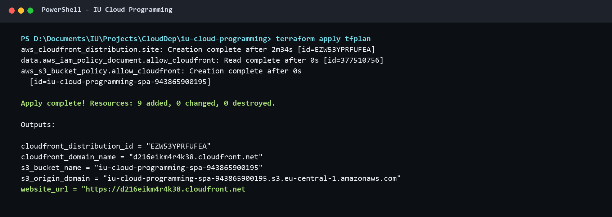
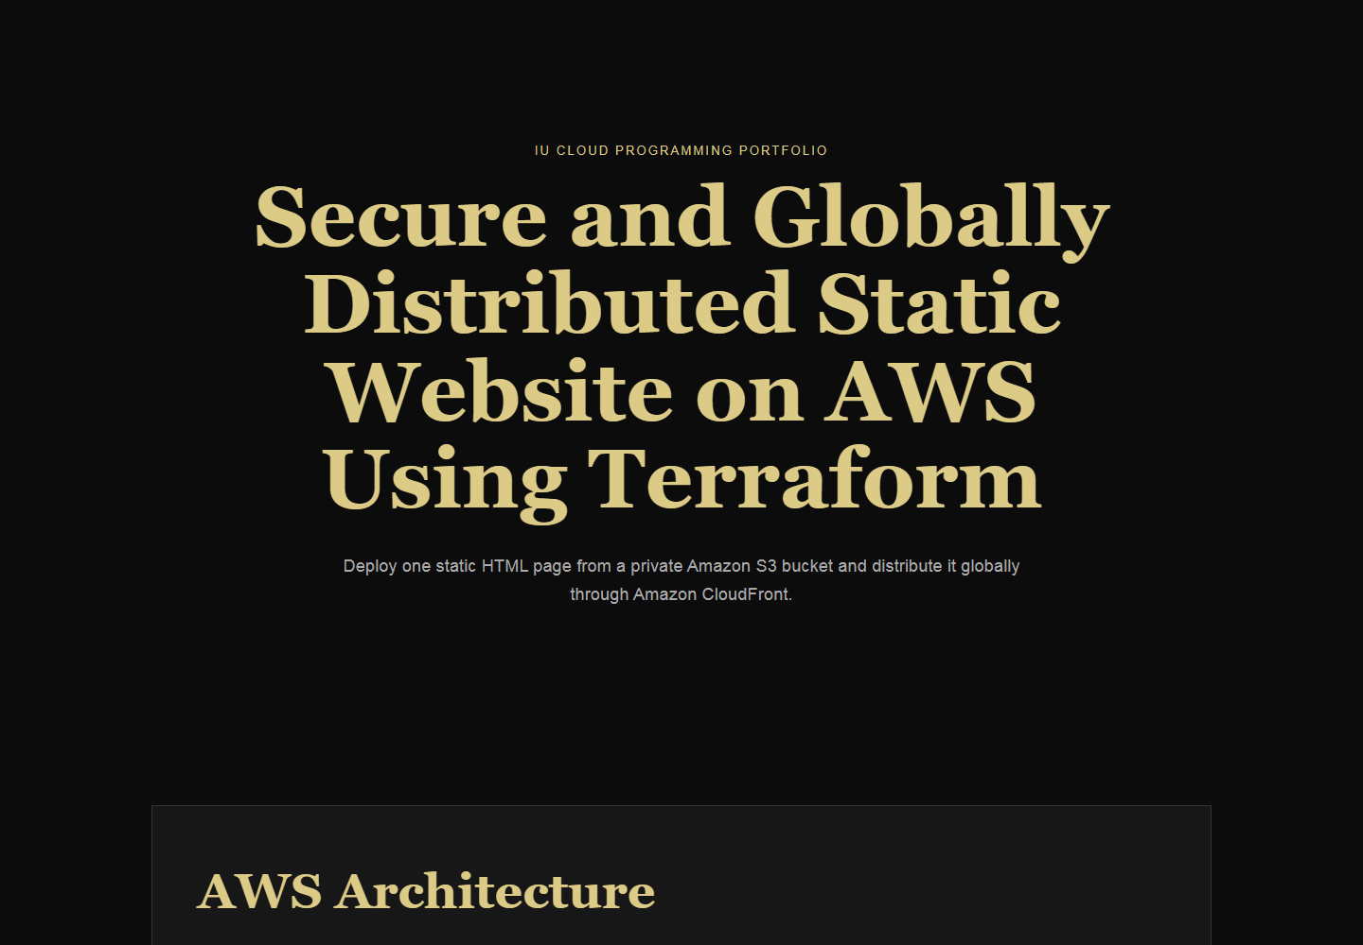
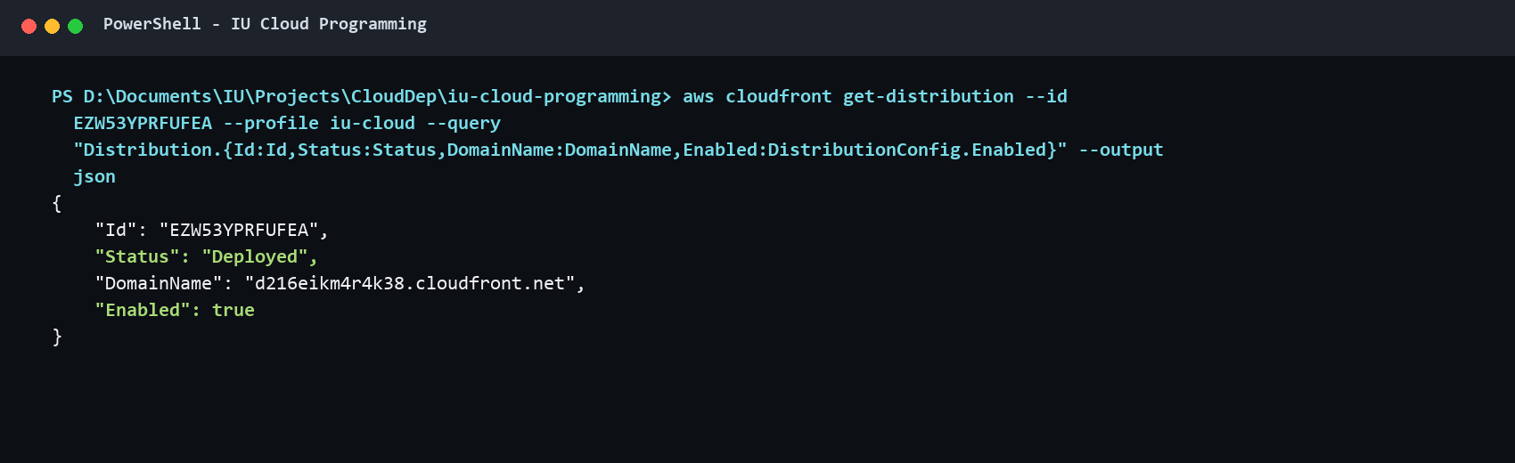
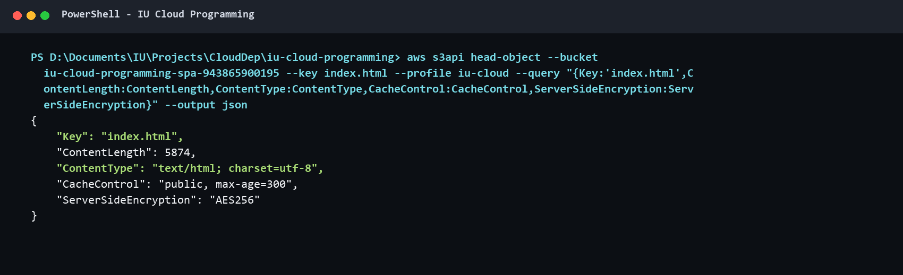
Deployment evidence confirms the design
Terraform apply: 9 resources created.
Live website served through CloudFront HTTPS.
CloudFront distribution status: Deployed.
S3 object metadata confirms HTML, cache and encryption.
Figures 2–5. Genuine deployment and AWS verification outputs captured on 17 July 2026.
08

Slide 9
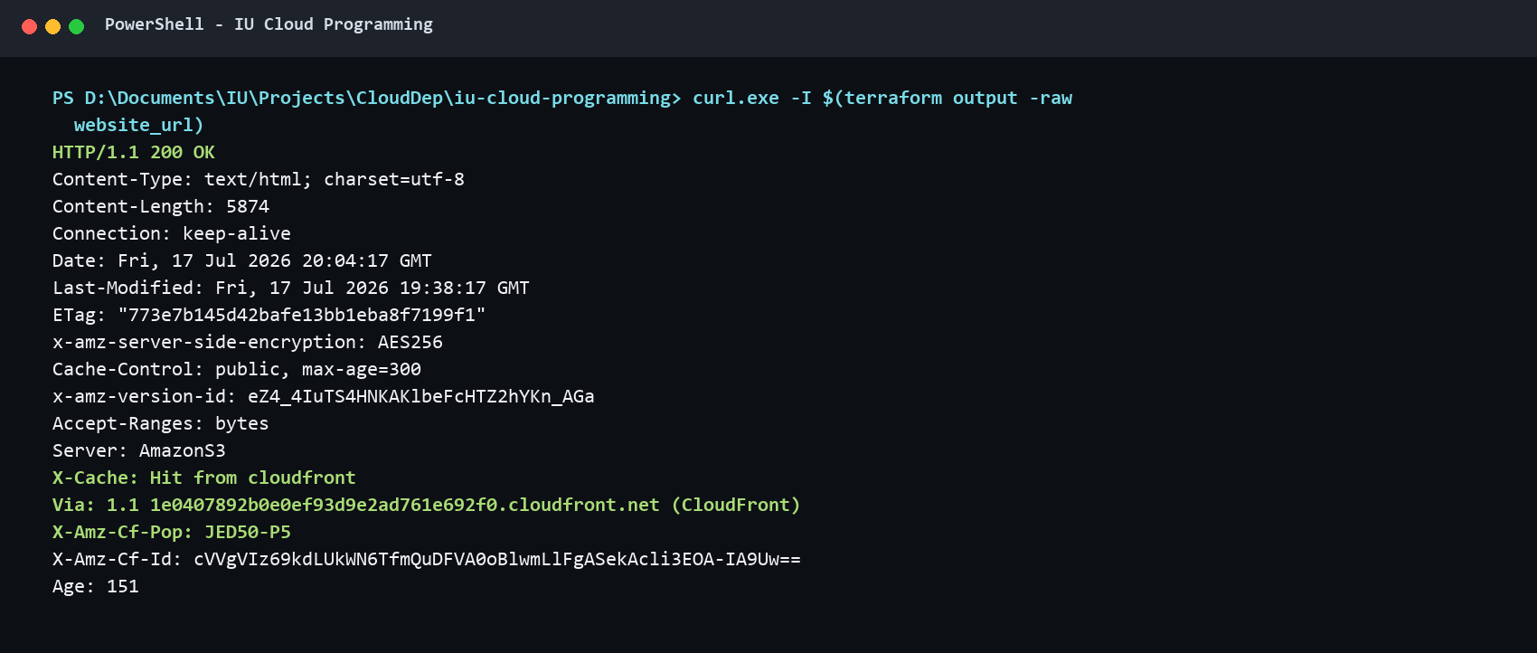
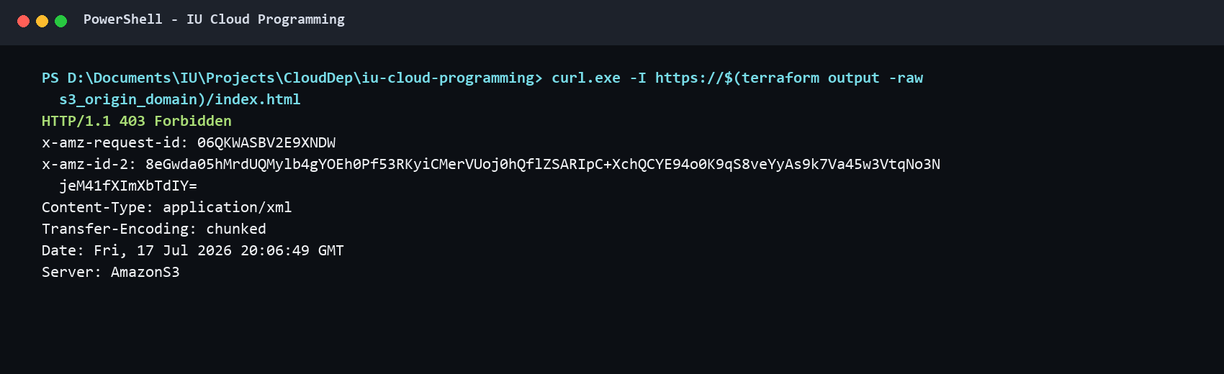
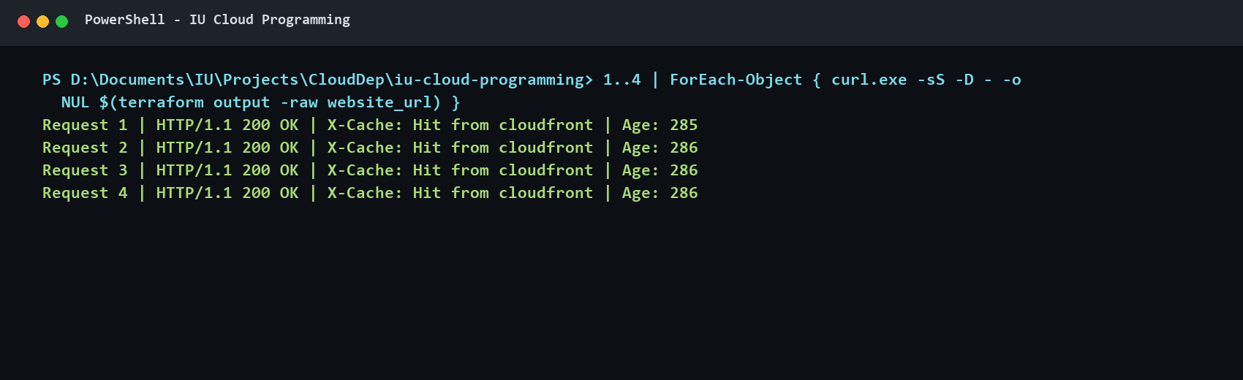
Tests confirm security and repeatability
TEST OUTCOMES
• HTTPS response: PASS
• HTTP → HTTPS redirect: PASS
• Direct S3 denial: PASS
• Public Access Block: PASS
• CloudFront cache hit: PASS
• Terraform no-change plan: PASS
HTTPS 200 + CloudFront headers
Direct S3 request denied (403)
Reflection
The strongest evidence combines positive delivery tests with negative origin-access tests and a final idempotency check.
Repeated request: Hit from CloudFront
Figures 6–8. Test evidence; full results are recorded in evidence/test-results.md.
09

Slide 10
The architecture meets every core requirement
RESULT
References
A globally accessible HTTPS site backed by a private S3 origin and reproducible Terraform configuration.
Amazon Web Services. Amazon CloudFront Developer Guide.
https://docs.aws.amazon.com/AmazonCloudFront/latest/DeveloperGuide/Introduction.html
Amazon Web Services. Restrict access to an Amazon S3 origin.
https://docs.aws.amazon.com/AmazonCloudFront/latest/DeveloperGuide/private-content-restricting-access-to-s3.html
Amazon Web Services. Data protection in Amazon S3.
https://docs.aws.amazon.com/AmazonS3/latest/userguide/DataDurability.html
HashiCorp. What is Terraform?
https://developer.hashicorp.com/terraform/intro
LIMITATIONS
Default CloudFront domain; no WAF, CI/CD or custom observability; designed for one static page.
FUTURE IMPROVEMENTS
Optional custom domain and ACM certificate, automated deployment, logging and budget alarms—only when justified by scope.
Code snapshot
https://github.com/MahmoudBKanaan/AWS-Deployment/tree/portfolio-part-2-first-draft/iu-cloud-programming
Conclusion: secure edge delivery without unnecessary compute infrastructure.
10

